Slide 1
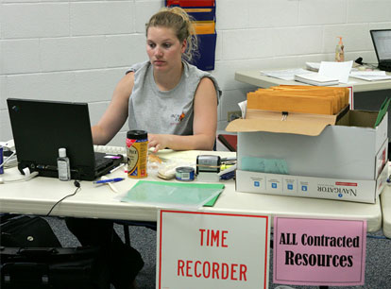
Demobilization
Unit 9

Slide 2
Objectives
Demonstrate the functionality of the “Incident Resource” screen.
Demonstrate the demobilization of resources from an incident.
Describe reassignment of resources.
D-110 Unit 9: Demobilization
9-1-D110-EP

